Slide 1
Intelligent Cities: Enabling Tools and Technology Chapter 1
Envisioning Intelligent Cities

Slide 2
Questions to Consider
What is becoming “Smart”?
What type of everyday devices are “Smart”?
What are ICT – Information & Communication Technologies?
Explain “remotely hosted software applications and data”.
We are living in an IoT (Internet of Things).

Slide 3
Key Drivers / Trends
Governments & their Constituents
Versatile and Value-Added Technologies
Challenges of Smart Cities

Slide 4
Intelligent City Stakeholders
Immigrants
Skilled Workers
Innovators
Investors
Local governments
Entrepreneurs

Slide 5
Newer & Nimbler Techniques
Stimulating & Sustainable foundations
Knowledge generation
Corroboration
Correlation
Dissemination

Slide 6
Clouds
IT Infrastructure Central & Core
Hosting
Managing
Delivering people-centric city services
Applications
Data

Slide 7
Cloud Enablement = Service Enablement
Accessibility
Simplicity
Consumability of city services
Intuitive & Natural Interfaces
Service Implementation Platforms
Pervasive
Persuasive

Slide 8
City Government Future
Transparent
Auditable
Responsible
Accountable
Minimizing:
Wastage
Pilferage
Slippage
Shrinkages

Slide 9
City-Specific Challenges: Rapid / Unbridled Urbanization
Limited Resources (Energy & Clean Water)
Continued Growth
Already Overloaded & Overcrowded Cities
Global Warming
Lack of / Poor City Infrastructures
Decline in Security (People & Property)
Slide in Seamless Transport

Slide 10
More with Less…
Budget Cuts
Dissatisfaction
Deteriorating Cities
Rationalization
Simplification
Optimization
Standardization
Automation
Adoption & Adaptation of IT

Slide 11
City Obstacles
Environment sustainability & Ecological degradation → Climate → Greenhouse gases → Carbon Dioxide & Methane
Plethora of People & Scarcity of Resources
Rapid urbanization → exposing infrastructure weaknesses & insufficiency

Slide 12
Trickling Urbanization Challenges
Why are people flocking to cities?
Formulating & Framing Policies
Developmental Roadmaps
Processes
By 2050, 70% will live in Cities!
Notes:
Suitable jobs & to sustain their livelihoods

Slide 13
City Factoids
More people live in urban than rural areas since 2007
Urban spaces 2% of the Earth’s surface
60% of the World’s population
Consuming 75% of global energy
Emit 80% of CO₂

Slide 14
Smarter Cites → Smarter World
“… cities also open up fresh opportunities for individuals, innovators, and institutions to contemplate and do different things for the betterment of societies and communities.” (Page 8)

Slide 15
Desired City Renovations
Infrastructure optimization
Technology adaptation and adoption
Process excellence
Architecture assimilation
Making sense of data and leveraging it for city efficiency

Slide 16
Comprehensive Virtualization
Involving every tangible element
Started with server virtualization
Moving towards: storage, networks, desktop, service, application, data, OS virtualization (alternatively termed as containerization)

Slide 17
System Infrastructure (Page 9)
Application data infrastructure
Development, execution, and management platforms and containers, databases, cubes, marts, and warehouse…
Middleware & management infrastructure
Integration hubs, buses, backbones, engines and fabrics, messaging brokers…
Intensifying complexity of IT space
Technologies, products, programming languages, design approaches, protocols, data formats…

Slide 18
Adoption of Versatile Technologies: (Page 10)
Digitalization is spreading quickly = self-, situation-, & surroundings- aware technology
Digitalization toward sentient and smart materials = attaching digital sensors and actuators, stickers, tags, labels, motes, dots, specks…
Consumerization (extended device landscape) = mobile, wearable, implantable, & portable devices
Extreme and deeper connectivity = ad hoc distributive connectivity
Cyber physical systems (CPSs) = cyber-enabled

Slide 19
Adoption of Versatile Technologies: Continued… (Page 10 & 11)
Commoditization and industrialization = components produced in massive volumes
Infrastructure optimization = Cloud, Central, & Next gen to be consolidated, converged, centralized yet federated (united), virtualized, automated, & shared
Middleware solutions = intermediation, aggregation, dissemination, arbitration, enrichment, collaboration, delivery, management, governance, brokering, id, & security
New kinds of data-driven insights = big & fast data analytics
New kinds of databases = analytical, clustered, parallel & distributed

Slide 20
“Everything is a Service!” Transformation
“Data, applications, platforms, and even infrastructures are being consciously codified and commingled as publicly discoverable, remotely accessible, autonomous (independent), highly available, usable, reusable, and composable (combining) services.”
Services are Everything is a strategic shift

Slide 21
“Tectonic Transition
Empowers every service (thing) to dynamically find, understand, bind, and leverage the unique capabilities of services (things) over any network.” (Page 14)

Slide 22
Devices Should…
“Diverse, distributed, and decentralized devices, data sources, and applications are expected to dynamically find, deftly bind, and decisively leverage one another to derive and deliver highly smart and sophisticated services to people in the years to come.” (Page 14)

Slide 23
“Increasingly a variety of personal as well as professional devices are becoming intricately yet intimately linked to a growing array of cyber applications, sensor and actuation networks, policy and knowledge bases, social network sites, and data sources in cloud servers and storages.” (Page 15)

Slide 24
“Process Engineering & Enhancement
…Inscribing fresh process consolidation and orchestration, process innovation, control, reengineering, process governance, and management mechanisms.” (Page 16)

Slide 25
Measurable City Processes
Lifestyle processes of the city population
Department services performance
Public sentiment may reveal design gaps
Constituents responses & feedback

Slide 26
“Clusters of Services”(page 16)
People-centric
Streamline multi-process
Integrates services across departments
Seamlessly

Slide 27
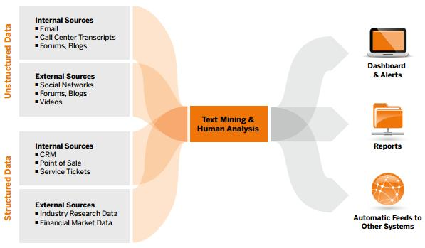
Data Structure
Note: Semi-structured data has some information missing, but not as much as unstructured!

Slide 28
Big Data is Better Data by Kenneth Cukier
Ted Talks!
https://www.ted.com/talks/kenneth_cukier_big_data_is_better_data?language=en
15:51 minutes
“Capturing and capitalizing big data (greater data volume, variety, velocity, variability….)”(Page 17)

Slide 29
“Best practices, patterns, platforms, processes, and products are being unearthed and built to smooth the route toward the envisioned people-centric IT.” (Page 18)

Slide 30
“… Ambient Intelligence (AmI)
Are not far away with the speed and astuteness with which scores of implementation technologies are being developed and sustained.”
“Fully knowledge-driven society”
“Knowledge systems & networks are readied for autonomic systems.”
“Seamlessly connect, collaborate, corroborate, & correlate to understand our mental, social, and physical needs…” (Page 19)

Slide 31
Smart Environment (Page 20)
Hi-Def IP TVs
e-Clothes
“Everyday places will be informative, interactive, intuitive, and inspiring by embedding intelligence and autonomy into their constituents:
Audio/video/camera systems
Web appliances
Consumer & household electronics
Other electronic gadgets (digitally augmented walls, floors, windows, doors, ceilings”, and other tangibles…

Slide 32
Cloud Computing Tutorial
https://www.youtube.com/watch?v=uYGQcmZUTaw
4:44 minutes

Slide 33
“System of Systems”
Combines modules (hospitals, companies, city infrastructure, stores, restaurants, bus stations, airports, resorts, and more)
Smart Homes
Security and Surveillance
Remote Asset Management
Connected Goods
Connected Consumer Electronics

Slide 34
Brilliant designs to fit more people in every city
By: Kent Larson
https://www.ted.com/talks/kent_larson_brilliant_designs_to_fit_more_people_in_every_city
16:35 minutes

Slide 35
Smarter Buildings
Building automation system = automatic control of various electronic systems
Energy management system = efficiency power consumption
Security and safety of people and properties
Remote operations and management of multiple devices
Ambient assisted living (AAL)
Smart bus/train stations and ports
Smart traffic

Slide 36
Smarter City Infrastructures(page 29 & 30)
IP Network Infrastructure = set protocol & fiber optics during building construction
Converged Communication = VoD (Video on Demand)
Infrastructure and Platform Software Solutions = empower all tangible things to behave intelligently
Cognitive Services to Citizens = Create people-centric applications

Slide 37
Smart City Goal
“… city-wide ambient, adaptive, and unified communications network is the base infrastructure to have connected cities wherein people find, bind, interact, participate, and collaborate with one another in realizing their unique necessities (temporal, spatial, physical, mental, etc.)” (Page 30 & 31)

Slide 38
Leading Smart City Platforms
“A city needs to use the IT advancements effectively to deliver multipurpose services and actionable intelligence to its constituents. The GOAL of anytime, anywhere, any device, any network, any media, and any application access can be accomplished through the smart leverage of IT.” (Page 31)

Slide 39
IBM Intelligent Operations Center
IBM Intelligent Operations Center for Emergency Management
https://www.youtube.com/watch?v=vz5CrGxLXzM
3:59 minutes
IBM Edge2015 "Demo: IBM® Intelligent Operations Center" by IBM VP Deon Newman
https://www.youtube.com/watch?v=4F94nqG3jXc
7:19 minutes

Slide 40
IBM IOC (Intelligent Operations Center)
Incident reporting & tracking
Situational awareness & reporting
Support for creating and using standard operating procedures
Real-time collaboration
Resource & critical asset management
Assessing & displaying KPIs (key performance indicator)
Open standard connection
GUI

Slide 41
Oracle City Platform
City Infrastructure and Sustainable City
https://www.youtube.com/watch?v=PaEcrHiM0pg
9:40 minutes

Slide 42
Oracle’s City Platform Benefits: (Page 34)
24/7 access to government services
Single non-emergency number (SNEN)
Face-to-face focused up-front personal connection for complex issues
Closed feedback loop for desired outcome
Constituents don’t need to understand government organizations to obtain service

Slide 43
Thales Hypervisor Supervision System
“Streamlining security and services to deliver operational efficiency
Thales Hypervisor is an innovative, intelligent and modular integrated solution designed for the real time security and operation management of complex infrastructure (airports, energy and utilities, defense sites and government premises), transportation systems (including urban rail, main lines and roads) and cities (urban security and the protection of massive public gatherings).”
https://www.thalesgroup.com/en/worldwide/security/what-we-do/city/urban-security/hypervisor
1:36 minutes
See Features & Benefits at the aforementioned link

Slide 44
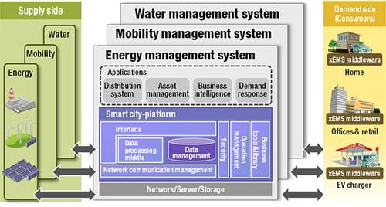
Hitachi Smart City Platform Solution for Hitachi’s Reference Architecture
http://www.planetanalog.com/author.asp?section_id=3175&doc_id=563609

Slide 45
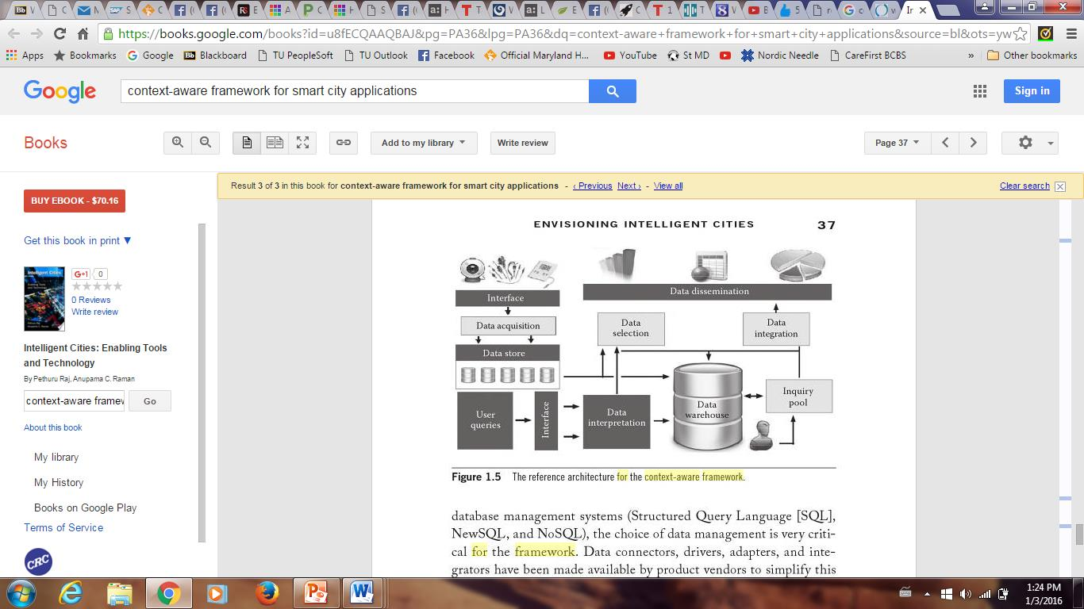
Figure 1.5 (Page 37)

Slide 46
Context-Aware Framework for Smart City Applications (Pages 36 – 38)
Data Collection & Cleansing
Data Storage
Data Interpretation
Cloud-Based
Data Dissemination

Slide 47
How would you make…?
Smart Traffic
Smart Healthcare
Smart Safety / Security
Smart Services Delivery
Smart Energy
Smart Banking
Smart Businesses

